Slide 1

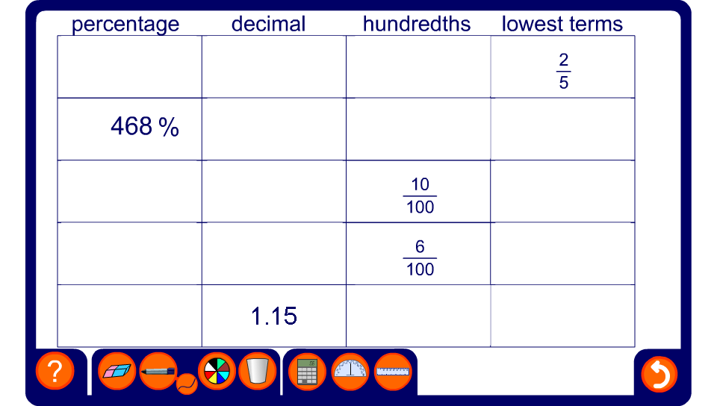


Table of equivalences
Notes:
Ask pupils to work out each fraction, decimal and percentage conversion. Fill in the table by clicking on each empty cell.

